Slide 1

NBA Championship Team Analysis
1991 – 2018 Championship Season
By: Ahmed Lawal
This Photo by Unknown Author is licensed under CC BY-SA

Slide 2
NBA Team Championship Participation
Summary of NBA Team Salary Variance
Power BI Desktop
Team Count of Team Season  Atlanta Hawks 28
Boston Celtics | 28
Chicago Bulls | 28
Cleveland Cavaliers | 28
Dallas Mavericks | 28
Denver Nuggets | 28
Detroit Pistons | 28
Golden State Warriors | 28
Houston Rockets | 28
Indiana Pacers | 28
Los Angeles Clippers | 28
Los Angeles Lakers | 28
Miami Heat | 28
Milwaukee Bucks | 28
Minnesota Timberwolves | 28
New York Knicks | 28
Orlando Magic | 28
Philadelphia 76ers | 28
Phoenix Suns | 28
Portland Trailblazers | 28
Sacramento Kings | 28
San Antonio Spurs | 28
Utah Jazz | 28
Toronto Raptors | 23
New Jersey Nets | 22
Washington Wizards | 21
Seattle SuperSonics | 18
Memphis Grizzlies | 17
Charlotte Hornets | 16
New Orleans Hornets | 13
Charlotte Bobcats | 10
Oklahoma City Thunder | 10
Team  | Sum of Team Salary | Sum of Salary Cap | Sum of Variance | %GT Sum of Variance
Atlanta Hawks | $1,381,671,710 | $1,247,511,000 | ($134,160,710) | 1.76%
Boston Celtics | $1,536,392,048 | $1,247,511,000 | ($288,881,048) | 3.80%
Brooklyn Nets | $542,127,921 | $443,024,000 | ($99,103,921) | 1.30%
Charlotte Bobcats | $539,003,005 | $551,326,000 | $12,322,995 | -0.16%
Charlotte Hornets | $683,166,110 | $612,074,000 | ($71,092,110) | 0.93%
Chicago Bulls | $1,450,245,253 | $1,247,511,000 | ($202,734,253) | 2.66%
Cleveland Cavaliers | $1,575,838,140 | $1,247,511,000 | ($328,327,140) | 4.31%
Dallas Mavericks | $1,706,369,174 | $1,247,511,000 | ($458,858,174) | 6.03%
Denver Nuggets | $1,378,725,008 | $1,247,511,000 | ($131,214,008) | 1.72%
Detroit Pistons | $1,419,991,472 | $1,247,511,000 | ($172,480,472) | 2.27%
Golden State Warriors | $1,472,674,343 | $1,247,511,000 | ($225,163,343) | 2.96%
Houston Rockets | $1,484,356,648 | $1,247,511,000 | ($236,845,648) | 3.11%
Indiana Pacers | $1,499,595,812 | $1,247,511,000 | ($252,084,812) | 3.31%
Los Angeles Clippers | $1,371,259,831 | $1,247,511,000 | ($123,748,831) | 1.63%
Los Angeles Lakers | $1,710,360,482 | $1,247,511,000 | ($462,849,482) | 6.08%
Memphis Grizzlies | $1,184,371,203 | $1,004,238,000 | ($180,133,203) | 2.37%
Miami Heat | $1,599,406,901 | $1,247,511,000 | ($351,895,901) | 4.62%
Milwaukee Bucks | $1,439,345,723 | $1,247,511,000 | ($191,834,723) | 2.52%
Minnesota Timberwolves | $1,431,355,642 | $1,247,511,000 | ($183,844,642) | 2.42%
New Jersey Nets | $1,018,889,873 | $804,487,000 | ($214,402,873) | 2.82%
New Orleans Hornets | $791,745,156 | $705,437,000 | ($86,308,156) | 1.13%
New Orleans Pelicans | $289,243,748 | $256,301,000 | ($32,942,748) | 0.43%
New York Knicks | $1,989,992,396 | $1,247,511,000 | ($742,481,396) | 9.75%
Oklahoma City Thunder | $774,075,486 | $675,492,000 | ($98,583,486) | 1.30%
Orlando Magic | $1,561,207,098 | $1,247,511,000 | ($313,696,098) | 4.12%
Philadelphia 76ers | $1,475,000,719 | $1,247,511,000 | ($227,489,719) | 2.99%
Phoenix Suns | $1,463,584,780 | $1,247,511,000 | ($216,073,780) | 2.84%
Portland Trailblazers | $1,776,429,569 | $1,247,511,000 | ($528,918,569) | 6.95%
Sacramento Kings | $1,403,471,925 | $1,247,511,000 | ($155,960,925) | 2.05%
San Antonio Spurs | $1,520,090,368 | $1,247,511,000 | ($272,579,368) | 3.58%
Seattle SuperSonics | $663,922,412 | $572,019,000 | ($91,903,412) | 1.21%
Total | $44,528,418,239 | $36,916,426,000 | ($7,611,992,239) | 100.00%
$54.57M
Average Yearly Salary
$45.24M
Average Yearly Cap
$137.49M
Max Salary
$99.09M
Max Cap
Total
816

Slide 3
Summary of Variance in NBA Championship Team Cap
Sum of Team Salary Sum of Salary Cap Sum of Variance
$2.0bn
Power BI Desktop
Sum of Team Salary, Sum of Salary Cap and Sum of Variance
$1.5bn
$1.0bn
$0.5bn
$0.0bn
($0.5bn)
($1.0bn)
Miami Heat
Phoenix Suns
Utah Jazz
Boston Celtics
Indiana Pacers
Chicago Bulls
Detroit Pistons
Atlanta Hawks
Brooklyn Nets
New York Knicks
Dallas Mavericks
Orlando Magic
Houston Rockets
Milwaukee Bucks
Sacramento Kings
Denver Nuggets
Toronto Raptors
New Jersey Nets
Charlotte Hornets
Charlotte Bobcats
Los Angeles Lakers
Cleveland Cavaliers
San Antonio Spurs
Philadelphia 76ers
Memphis Grizzlies
Washington Bullets
Portland Trailblazers
Washington Wizards
Seattle SuperSonics
Vancouver Grizzlies
Golden State Warriors
Los Angeles Clippers
New Orleans Hornets
New Orleans Pelicans
Minnesota Timberwolves
Oklahoma City Thunder
Team

Slide 4
Sum of Team Salary by Team
New York Knicks Portland Trailbla… Los Angeles Lak… Dallas Mavericks Miami Heat Cleveland Cavali… Orlando Magic Boston Celtics San Antonio Sp… Indiana Pacers
Houston Rockets Philadelphia 76e… Golden State W… Phoenix Suns Chicago Bulls Milwaukee Bucks Minnesota Timb… Detroit Pistons Sacramento Kings Atlanta Hawks Denver Nuggets Los Angeles Clip… Washington Wiz… Toronto Raptors
Utah Jazz Memphis Grizzlies New Jersey Nets New Orleans Ho… Oklahoma City T… Charlotte Hornets
$0bn
Average of Team Salary by Team
Count of Championship by Team
Power BI Desktop
$2.0bn
$1.8bn
$1.7bn
$1.7bn
$1.6bn
$1.6bn
$1.6bn
$1.5bn
$1.5bn
$1.5bn
$1.5bn
$1.5bn
$1.5bn
$1.5bn
$1.5bn
$1.4bn
$1.4bn
$1.4bn
$1.4bn
$1.4bn
$1.4bn
$1.4bn
$1.4bn
$1.4bn
$1.4bn
$1.2bn
$1.0bn
$0.8bn
$0.8bn
$0.7bn
New Orleans … Brooklyn Nets Oklahoma Cit… New York Knic… Memphis Griz… Washington … Portland Trailb… Los Angeles L… Dallas Maveric… New Orleans … Toronto Raptors Miami Heat Cleveland Cav… Orlando Magic Boston Celtics San Antonio S… Charlotte Bob… Indiana Pacers Houston Rock… Philadelphia 7… Golden State … Phoenix Suns Chicago Bulls Milwaukee Bu… Minnesota Ti… Detroit Pistons Sacramento Ki… Atlanta Hawks Denver Nugg… Los Angeles Cl…
Utah Jazz
$0M
$96M
$90M
$77M
$71M
$70M
$65M
$63M
$61M
$61M
$61M
$59M
$57M
$56M
$56M
$55M
$54M
$54M
$54M
$53M
$53M
$53M
$52M
$52M
$51M
$51M
$51M
$50M
$49M
$49M
$49M
$49M
$50M $100M
Average of Team Salary
Chicago Bulls
6
Los Angeles L…
5
San Antonio …
5
Golden State …
3
Team
Team
Miami Heat
3
Team
Houston Rock…
2
Boston Celtics
1
Cleveland Ca…
1
Dallas Maveri…
1
Detroit Pistons
1
$1bn $2bn
Sum of Team Salary
0
5
Count of Championship

Slide 5
Team Average Yearly Salary and Number of Championships Won Championship 1991 1992 1993 1994 1995 1996 1997 1998 $120M | 1999 | 2000 | 2001 | 2002 | 2003 | 2004 | 2005 | 2006 | 2007 | 2008 | 2009 | 2010 | 2011 | 2012 | 2013
Power BI Desktop
$100M
Average of Team Salary
$80M
$60M
$40M
$20M
Golden State Warriors
Cleveland Cavaliers
Boston Celtics
Dallas Mavericks
Miami Heat
Los Angeles Lakers
San Antonio Spurs
Detroit Pistons
Chicago Bulls
Houston Rockets
Team

Slide 6
Team Salary Range and Championship Participation
Power BI Desktop
Team Team Salary Range Count of Championship Year
Average Yearly Cap and Average Yearly Salary by Team
Average Yearly Cap Average Yearly Salary

New Orleans Pelicans <$1b 3
Brooklyn Nets <$1b 6
Vancouver Grizzlies <$1b 6
Washington Bullets <$1b 7
Charlotte Bobcats <$1b 10
Oklahoma City Thunder <$1b 10
Golden State Warriors
New Orleans Hornets <$1b 13
Charlotte Hornets <$1b 16
Cleveland Cavaliers
Memphis Grizzlies $1.01b-$1.5b 17
Seattle SuperSonics <$1b 18
Dallas Mavericks
Washington Wizards $1.01b-$1.5b 21
New Jersey Nets $1.01b-$1.5b 22
Toronto Raptors $1.01b-$1.5b 23
Atlanta Hawks $1.01b-$1.5b 28
Boston Celtics
Boston Celtics $1.51b-$2b 28
Chicago Bulls $1.01b-$1.5b 28
Miami Heat
Cleveland Cavaliers $1.51b-$2b 28
Dallas Mavericks $1.51b-$2b 28
Team
Denver Nuggets $1.01b-$1.5b 28
Detroit Pistons $1.01b-$1.5b 28
Golden State Warriors $1.01b-$1.5b 28
Houston Rockets $1.01b-$1.5b 28
Indiana Pacers $1.01b-$1.5b 28
Los Angeles Clippers $1.01b-$1.5b 28
Los Angeles Lakers $1.51b-$2b 28
Miami Heat $1.51b-$2b 28
Milwaukee Bucks $1.01b-$1.5b 28
Minnesota Timberwolves $1.01b-$1.5b 28
New York Knicks $1.51b-$2b 28
Orlando Magic $1.51b-$2b 28
Philadelphia 76ers $1.01b-$1.5b 28
Los Angeles Lakers
San Antonio Spurs
Detroit Pistons
Chicago Bulls
Houston Rockets
Phoenix Suns $1 01b-$1 5b 28
Total NA 816
$0M
$50M
$100M

Slide 7
Summary of NBA Team Salary Variance Analysis of Salary Team Variance
Team  |  | Sum of Team Salary | Sum of Salary Cap | Sum of Variance | %GT Sum of Variance | Championship (bi…× Team × 1992
Atlanta Hawks |  | $1,381,671,710 | $1,247,511,000 | ($134,160,710) | 1.76%
 | Boston Celtics | $1,536,392,048 | $1,247,511,000 | ($288,881,048) | 3.80%
Brooklyn Nets |  | $542,127,921 | $443,024,000 | ($99,103,921) | 1.30%
 | Charlotte Bobcats | $539,003,005 | $551,326,000 | $12,322,995 | -0.16% | 1989
Charlotte Hornets |  | $683,166,110 | $612,074,000 | ($71,092,110) | ^{0.93%} $26,954,000
 | Chicago Bulls | $1,450,245,253 | $1,247,511,000 | ($202,734,253) | 2.66% | Chicago Bulls
Cleveland Cavaliers |  | $1,575,838,140 | $1,247,511,000 | ($328,327,140) | _{4.31%} ($83,068,180) 1992
 | Dallas Mavericks | $1,706,369,174 | $1,247,511,000 | ($458,858,174) | 6.03% | ($173,677,545)
Denver Nuggets |  | $1,378,725,008 | $1,247,511,000 | ($131,214,008) | 1.72% Houston Rockets
 | Detroit Pistons | $1,419,991,472 | $1,247,511,000 | ($172,480,472) | 2.27% | ($90,609,365) 1995
Golden State Warriors |  | $1,472,674,343 | $1,247,511,000 | ($225,163,343) | ^{2.96%} ($322,107,599)
 | Houston Rockets | $1,484,356,648 | $1,247,511,000 | ($236,845,648) | 3.11%
Indiana Pacers |  | $1,499,595,812 | $1,247,511,000 | ($252,084,812) | 3.31% ₁₉₉₈
 | Los Angeles Clippers | $1,371,259,831 | $1,247,511,000 | ($123,748,831) | 1.63% | ($696,445,784)
Los Angeles Lakers |  | $1,710,360,482 | $1,247,511,000 | ($462,849,482) | 6.08%
 | Memphis Grizzlies | $1,184,371,203 | $1,004,238,000 | ($180,133,203) | 2.37% | Sum of Variance 2016
Miami Heat |  | $1,599,406,901 | $1,247,511,000 | ($351,895,901) | ^{4.62%} ($7,611,992,239) ($702,871,153)
 | Milwaukee Bucks | $1,439,345,723 | $1,247,511,000 | ($191,834,723) | 2.52%
Minnesota Timberwolves |  | $1,431,355,642 | $1,247,511,000 | ($183,844,642) | 2.42% ₂₀₁₀
 | New Jersey Nets | $1,018,889,873 | $804,487,000 | ($214,402,873) | 2.82% | ($944,331,425)
New Orleans Hornets |  | $791,745,156 | $705,437,000 | ($86,308,156) | 1.13%
 | New Orleans Pelicans | $289,243,748 | $256,301,000 | ($32,942,748) | 0.43% | 2013
New York Knicks |  | $1,989,992,396 | $1,247,511,000 | ($742,481,396) | ^{9.75%} ($1,087,457,473)
 | Oklahoma City Thunder | $774,075,486 | $675,492,000 | ($98,583,486) | 1.30%
Orlando Magic |  | $1,561,207,098 | $1,247,511,000 | ($313,696,098) | 4.12% ₂₀₀₇
 | Philadelphia 76ers | $1,475,000,719 | $1,247,511,000 | ($227,489,719) | 2.99% | ($1,138,423,619)
Phoenix Suns |  | $1,463,584,780 | $1,247,511,000 | ($216,073,780) | 2.84%
 | Portland Trailblazers | $1,776,429,569 | $1,247,511,000 | ($528,918,569) | 6.95% | 2004
Sacramento Kings |  | $1,403,471,925 | $1,247,511,000 | ($155,960,925) | ^{2.05%} ($1,271,293,500)
 | San Antonio Spurs | $1,520,090,368 | $1,247,511,000 | ($272,579,368) | 3.58%
Seattle SuperSonics Total |  | $663,922,412 $44,528,418,239 | $572,019,000 $36,916,426,000 | ($91,903,412) ($7,611,992,239) | 1.21%  100.00%
Power BI Desktop

Slide 8
Summary of NBA Team Salary and Salary Cap
Sum of Team Salary Sum of Salary Cap
$2.0bn
Power BI Desktop
Sum of Team Salary and Sum of Salary Cap
$1.5bn
$1.0bn
$0.5bn
$0.0bn
Miami Heat
Phoenix Suns
Utah Jazz
Boston Celtics
Indiana Pacers
Chicago Bulls
Detroit Pistons
Atlanta Hawks
Brooklyn Nets
New York Knicks
Dallas Mavericks
Orlando Magic
Houston Rockets
Milwaukee Bucks
Sacramento Kings
Denver Nuggets
Toronto Raptors
New Jersey Nets
Charlotte Hornets
Charlotte Bobcats
Los Angeles Lakers
Cleveland Cavaliers
San Antonio Spurs
Philadelphia 76ers
Memphis Grizzlies
Washington Bullets
Portland Trailblazers
Washington Wizards
Seattle SuperSonics
Vancouver Grizzlies
Golden State Warriors
Los Angeles Clippers
New Orleans Hornets
New Orleans Pelicans
Minnesota Timberwolves
Oklahoma City Thunder
Team

Slide 9
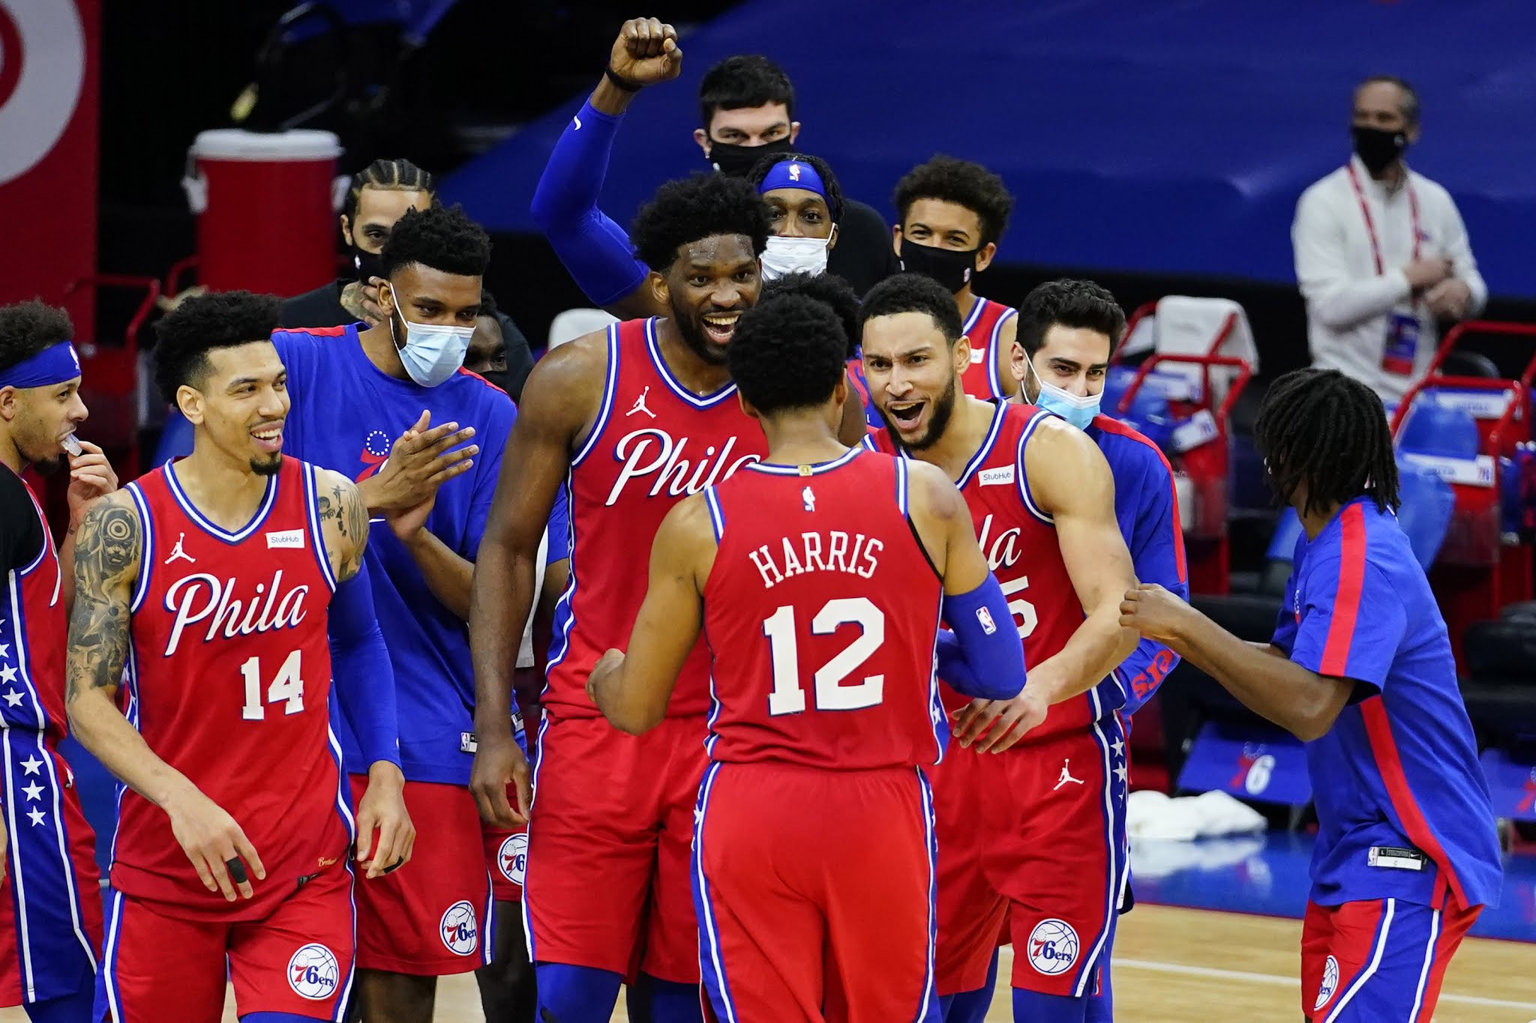
Slide 2 – NBA Team, Salary and Participation
.. The summary reveals that majority of the NBA teams that spend more in terms of staff remuneration did not miss out in participation in any of the championship season. Almost all the championship teams exceeded their Salary cap. …
… Key Statistics?
On the average championship team yearly salary is about $54.57m, while their yearly cap is about $45.24m. Maximum Salary incurred and Cap for the period considered are 137.49m & $99.09m respectively
This Photo by Unknown Author is licensed under CC BY-NC-ND

Slide 10
Takeaways from Slide 3? Team Salary Variance
Lowest Variance: New York Knicks Portland Trailblazers Los Angeles Lakers
Highest Variance: Washington Bullets Vancouver Grizzles New Orleans Pelicans

Slide 11
Slide 4 – Analysis of Total & Average Salary by Team Vs. Number of Championships Won
Expected Outcome
Logical reasoning – It is expected that the teams that incure the highest salary will win most championships. However, the result of the analysis shows otherwise.
Facts and Figures
Only 10 out of the 36 teams that have participated in the 28 yearly NBA championships have won the championship. Top 3 winners are Chicago Bull (6 times), while Los Angeles Lakers and San Antonio Spurs won 5 times.
Findings
Only 3 out of the top 5 clubs with the highest total salary have ever won the championship, they are Los Angeles Lakers, Dallas Mavericks and Miami Heat. While only Lakers and Dallas, out of the top 10 NBA paying teams in terms of average yearly salary have won the championship.
Conclusion
Teams payment of high salary does not necessarily translate into winning more championship. The analysis revealed that other factors such as staff welfare and training might be crucial motivating factor for winning championship. The likes of Chicago Bull and San Antonio Spurs who won championship are not in top 10 highest paying teams.

Slide 12
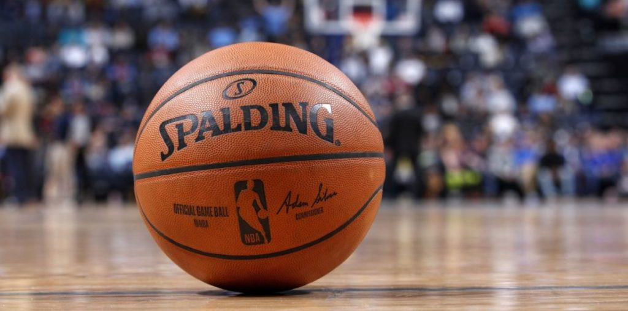
Slide 5 – Team Average Yearly Salary vs. Number of Championship Won.
-
-The chart revealed that average yearly salary of majority of the teams that won championship is below $60m.
- Followed by teams with average salary of $60m to $80m.
- Only few out of the teams paying average salary of above $80m won championship.

Slide 13
Slide 6 – Top 3 Teams with the Highest Average Yearly Salary
Highest Avg. Yearly Salary
2. Cleveland Cavaliers
3. Dallas Mavericks
1. Golden State Warriors

Slide 14
Slide 7 – Analysis of NBA Teams Salary Variance
Variance
$7.6B salary was incurred in excess of Salary Cap by NBA Championship Teams between 1991 and 2018.
Further Analysis showed that only Chicago Bulls and Houston Rocket were responsible for about $183m adverse variance in 1992.

Slide 15
Slide 8 – NBA Team Salary and Salary Cap
Bottom 5 Teams
Top 5 Teams
New Orleans Pelicans
Vancouver Grizzles
Portland Trailblazers
New York Knicks
Washington Bullets
Charlotte Bobcats
Brooklyn Nets
Los Angeles Lakers
Dallas Mavericks
Miami Heat

Slide 16

Thank you.
Please note, the statistics used for this analysis covers only the years between 1991 to 2018 that the 36 respective teams participated in the championship.
This Photo by Unknown Author is licensed under CC BY-SA

